Slide 1
Emergency Response Solutions

Slide 2
FFD Initial SCBA Training - Objectives
The objective of this training is to prepare for the safe use of the MSA G1 SCBA in a dynamic, stressful, and constantly changing environment.
Only constant training and practice with the MSA SCBA will “YOU” develop the proficiency needed to operate safely and effectively in a real life situation.

Slide 3
FFD Initial SCBA Training
Components & Assembly
Donning / Doffing
Cleaning
Maintenance
Daily SCBA Check

Slide 4
Components
Cylinder
Harness
Regulators
Integrated Pass
Face Piece
HUD (Heads Up Display)

Slide 5
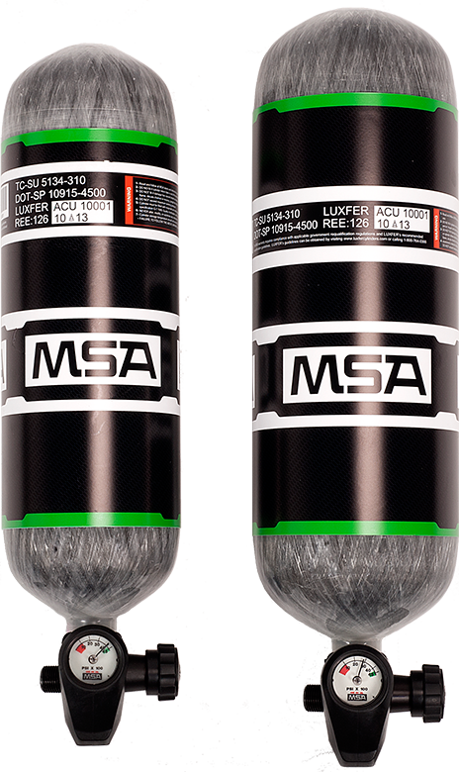
Pneumatics – Cylinders
MSA SuperLite Cylinders
More than a pound lighter than standard carbon wrapped cylinders
30 minute duration at 4500 psi
Large luminescent band and gauge face improves firefighter visibility
Gauge is calibrated in 100 psi. increments, (i.e. a gauge reading of 20 is read as 20 x 100 or 2000 psi.)

Slide 6
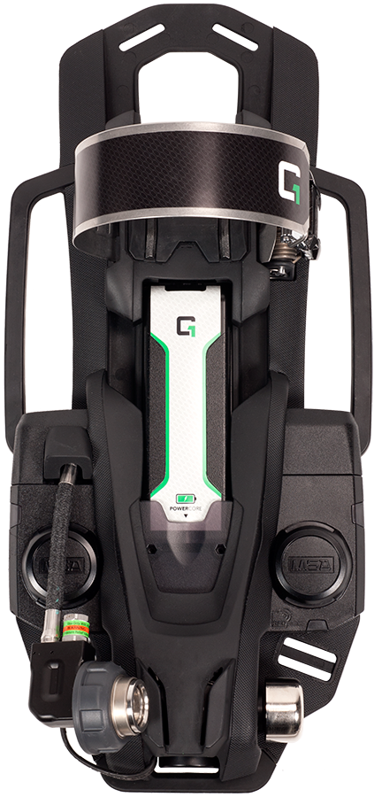
Carrier & Harness
Cylinder is retained at top and bottom of the carrier.
Cylinder dovetail connection ensures cylinder
is secure at the bottom of carrier
Dovetail also properly positions the cylinder
for simple and easy connection
New stainless steel cylinder band retains
the cylinder at the top of backframe
Cylinder band is fully adjustable for
different size cylinders

Slide 7
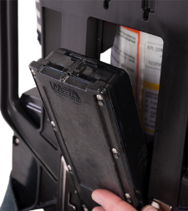
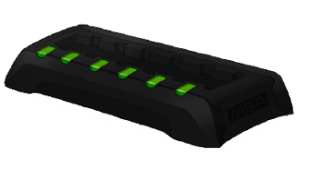
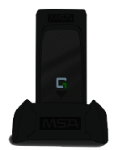
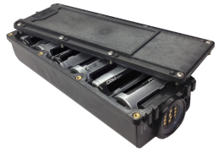
Central Power Supply
Powers all lights, communications and controls from one source
Battery type – lithium ion rechargeable
Battery location places weight low and close to the back for optimum balance and reduced fatigue

Slide 8
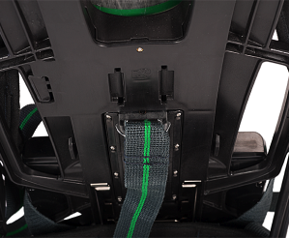
Central Power Supply
Battery status can be checked without powering-on SCBA
Battery can be changed while SCBA is fastened in jump seat
Convenient tool releases battery when inserted into slot
Need pictures from iPad app & brochure

Slide 9
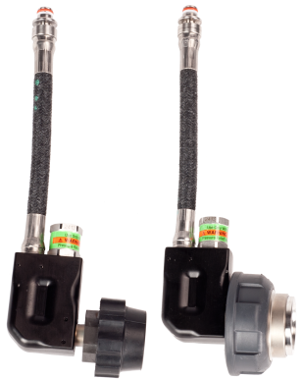
Pneumatics – Cylinder Connection
Cylinder Connection:
Remote Quick Connection

Slide 10
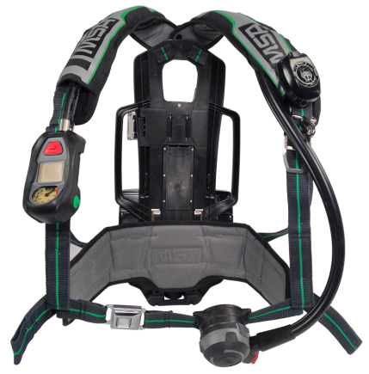
Carrier & Harness
Handle at top of back frame Static load rated to 1000lbs
Drag Rescue / carry handles on either side are static load
rated to 500lbs each

Slide 11
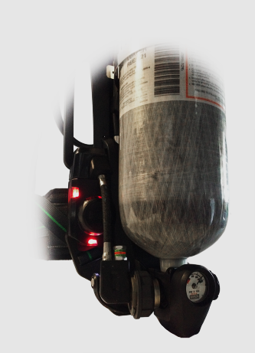
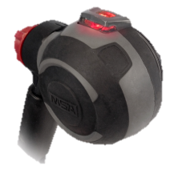
RIT, Rescue, Firefighter Survival
Buddy lights – six in total – are viewable 360 degrees and help in locating Firefighter
Color-coding of buddy lights show both air and alarm status
Reflective shoulder straps and luminescent cylinder band improve visibility

Slide 12
Carrier & Harness
Form-fit Shoulder Pads are wider, more flexible; Friction Pads prevent slippage
More reflective material improves visibility

Slide 13
Voice Amp
G1 Speaker Module
Speaker is small, light weight and durable
Automatic On/Off with integrated PASS device
Capable of passing the NFPA Heat and Emersion leakage test
Bluetooth ready

Slide 14
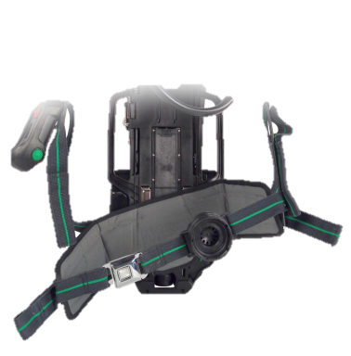
Carrier & Harness
Adjustable height lumbar pad can be user positioned to fit different body types and forms
Swiveling lumbar pad adjusts to body movements for better weight distribution, balance and comfort

Slide 15
Pneumatics – 1st Stage Reducer
Integration of 1st stage reducer, Bell Low Air Warning and URC fitting into one modular assembly
Mounted low and close to the back for optimum balance and weight distribution

Slide 16
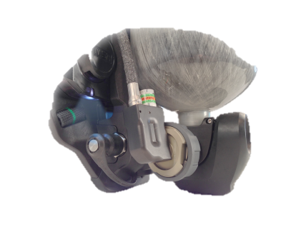
RIT, Rescue, Firefighter Survival
MSA URC fitting can be used to transfill between SCBAs
Waist-mounted ExtendAir 2 EBS “buddy breather” system

Slide 17
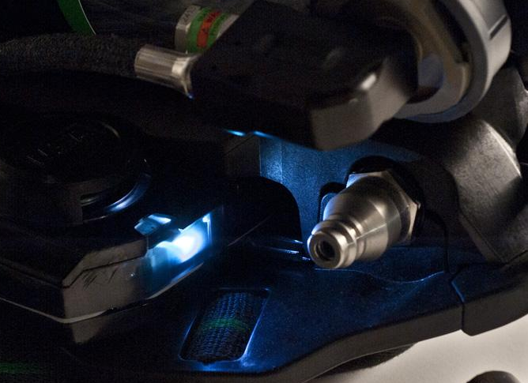
RIT, Rescue, Firefighter Survival
Rescue light automatically illuminates Universal Rescue Connection in low air situation

Slide 18
Service Tracking Software
The G1 is equipped with RFID tracking tags attached to all major components including: cylinder, facepiece, regulator, back frame, power module and control module
MSA asset tracking and service tracking software.

Slide 19
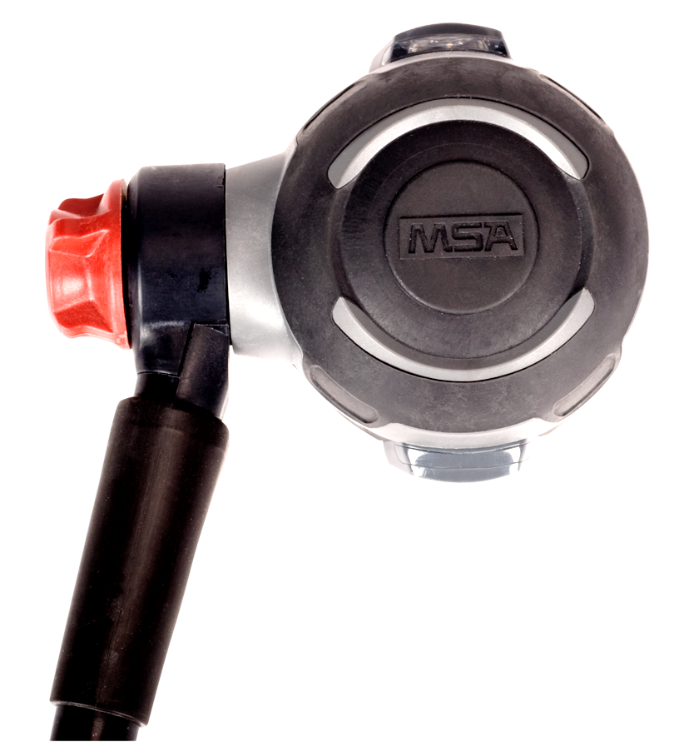
G1 Regulator
Large dual action buttons remove the regulator and automatically shut off the flow of air

Slide 20
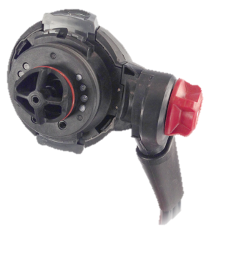
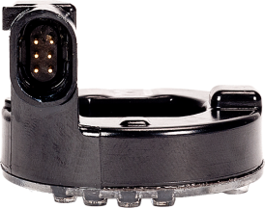
G1 Regulator
Electronics and Microphones are contained in a sealed module integrated into the regulator while maintaining a small, ergonomic form
HUD LEDs in the regulator use light pipes to carry light to the facepiece mounted icons
Smart Microphones shut off automatically when no voice signal is detected to conserve battery

Slide 21
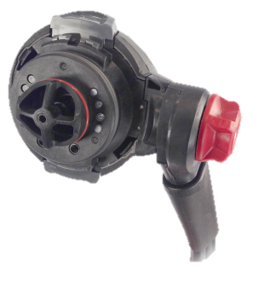
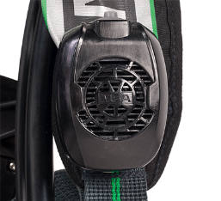
G1 Regulator
Dual microphones reduce background noise and feedback
Microphones are protected inside regulator to reduce cost of ownership
Communications electronics use proprietary algorithms to eliminate amplification of inhalation noise… No Darth Vader effect
Speaker module can be mounted on left or right shoulder

Slide 22
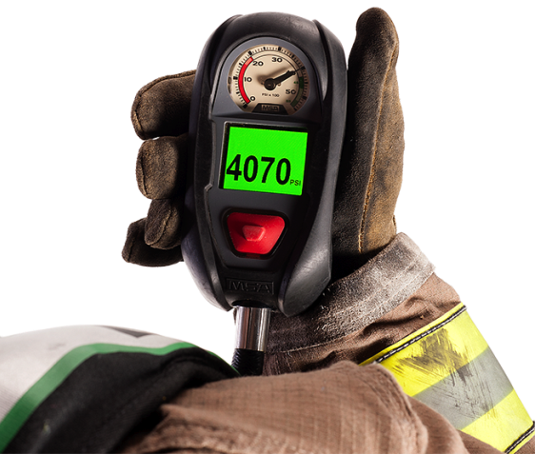
G1 Integrated PASS

Slide 23
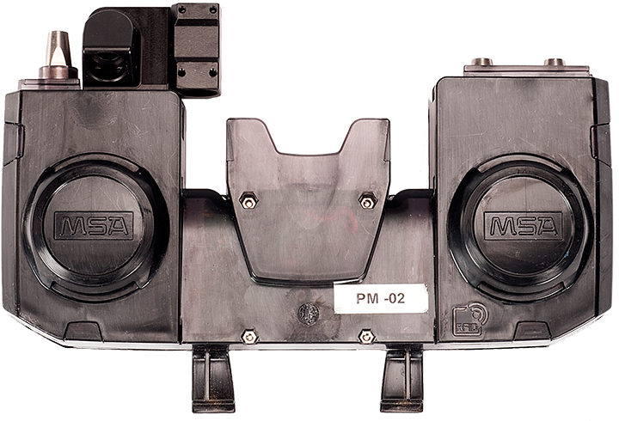
G1 Integrated PASS
Power Module
Control Module

Slide 24
G1 Control Module
Opening Screen

Slide 25
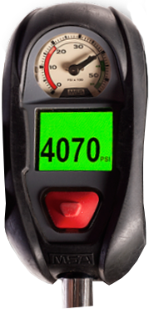
G1 Control Module
Auto-Activation turns on display when control module is lifted
Bright full color display with large numbers provides easy viewing
Built-in Bluetooth allows for integration with future technologies

Slide 26
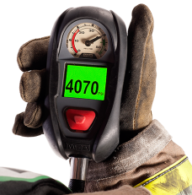
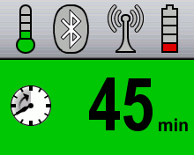
G1 Integrated PASS
Control Module
Auto Activation turns on display when control module is lifted
Bright full color display with large numbers allows easy viewing
Built in Bluetooth allows for integration with future technologies
Display settings are customizable

Slide 27
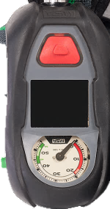
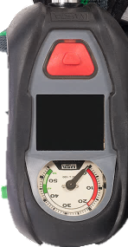
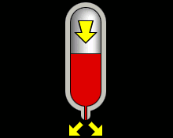
G1 Control Module
Configurable display to match FFD SOPs
Secondary Thermal Alarm
Low-Battery Alarm
Evacuation Alarm
Pressure Drop Alarm
Time Remaining Alarm

Slide 28
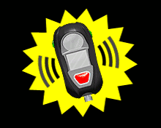
G1 Control Module
Configurable display to match FFD SOPs
Pressure Change
Pre-Alarm
Motion or Manual Alarm
Primary Thermal Alarm

Slide 29
G1 Facepiece

Slide 30
Facepiece Construction
Anti-Fog Lens
Heat Resistance Lens
Hycar Rubber Sealing Surface

Slide 31
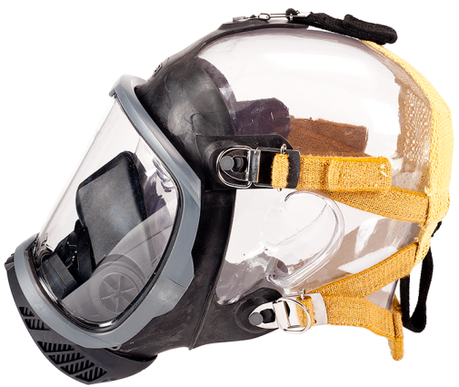
G1 Facepiece
No Electronics In or On the Facepiece
No batteries
Simplifies cleaning
Reduces weight and cost

Slide 32
G1 Facepiece
Inhalation Check Valve
Cross contamination protection
No need to decontaminate the regulator after use
Exhalation Valve in Facepiece
Opens to allow for release of exhaled breath
Also ejects moisture build-up
Exhalation Valve

Slide 33
G1 Facepiece
Inhalation Check Valve
Blocks exhaled air from entering regulator
Open Port
Reduces breathing resistance for standby breathing (off air)

Slide 34
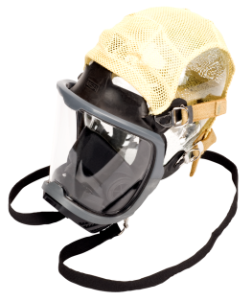
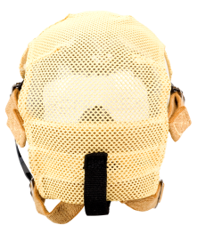
G1 Facepiece
Head Harness:
Mesh head harness
With neck strap or without
Facepiece & Nose Cups:
Small
Medium
Large

Slide 35
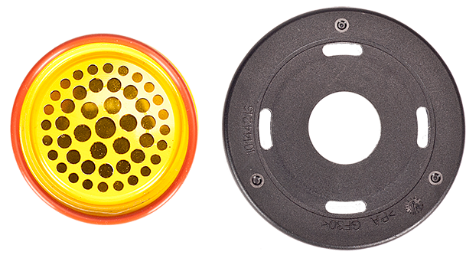
G1 Facepiece
Speech Diaphragm allows for clean transfer of voice through component housing
Vented Component Housing

Slide 36
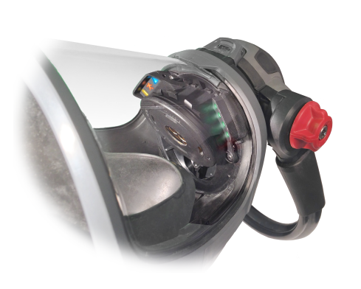
G1 Facepiece
Heads Up Display (HUD)
Uses light pipes to illuminate icon indicators
Colour coded icons show battery, evacuation and alert status
Speech Diaphragm
Aligns with wearer’s mouth
to provide clear, intelligible
speech either on or off air

Slide 37
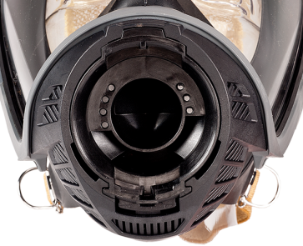
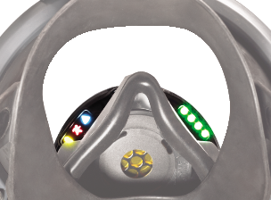
G1 Facepiece
Heads-Up Display
Light pipes transfer light into HUD windows
Right side provides air management information
Left side provides icons as system status indicators
(Includes Battery Icon, Evacuation Icon and PASS Pre-Alarm Icon)

Slide 38
HUD
• 4 green LED — Start-up or 100% displayed for 20 seconds before going out.
• 3 green LED — 75% displayed for 20 seconds before going out.
• 2 yellow LED — 50% begins flashing continuously with audio beep.
• 1 red LED — 0 to 35% activate and stay flashing accompanied by low pressure alarm until unit is shut down.
HUD activated anytime green button pushed

Slide 39
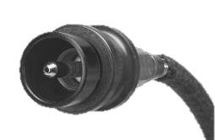
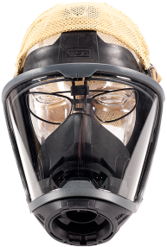
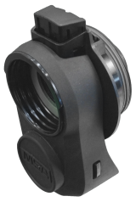
Accessory Equipment
Transfill Hose & Pouch
Spectacle Kit
APR Adapter

Slide 40
Cleaning & Disinfecting Face Piece
Wash Face Piece and nose cup in “Confidence Plus” cleaning solution or mild dish soap
Rinse thoroughly with clean water
Water temp. should not exceed 100 deg.
Towel dry bulk water
Purge exhalation valve
Replace nose cup and hang to dry

Slide 41
Cleaning & Disinfecting Pack
Rinse pack (battery needs to remain in Pack)
Brush with soapy water
Rinse thoroughly with clean water
Purge regulator
Towel dry bulk water (Inspect)
Air dry on apparatus

Slide 42
Daily SCBA Mask Check
1 Check the amount of air in cylinder and
replace if pressure indicator is below 4000
psi.

Slide 43
Daily SCBA Mask Check
2 Adjust shoulder & waist straps to fully open.
Set lumbar pad height to high, medium, or
low for personal fit.

Slide 44
Daily SCBA Mask Check
Confirm BUDDY-BREATHING HOSE is properly stowed.

Slide 45
Daily SCBA Mask Check
Confirm BYPASS KNOB is in the closed position.
Rotated clockwise against housing

Slide 46
Daily SCBA Mask Check
5 Press DONNING SWITCH.

Slide 47
Daily SCBA Mask Check
6 Open cylinder valve all the way and listen
for low air-warning signals.
✔Check Battery Level
✔Primary low air warning will ring
✔Pass device will chirp and light to confirm
operation
✔Verify HUD device will light up and show bar
indicators
✔Check Lights on backframe

Slide 48
Daily SCBA Mask Check
7 Pause approximately 18-20 seconds and
confirm pass device motion alarm
activates.

Slide 49
Daily SCBA Mask Check
8 Hold face piece to face establishing a good
seal, inhale to start. Take a couple breaths
to confirm proper operation.

Slide 50
Daily SCBA Mask Check
9 Press donning switch before removing face
piece from face.

Slide 51
Daily SCBA Mask Check
10 Close air cylinder all the way and listen for
any air leaks. (1 minute)

Slide 52
Daily SCBA Mask Check
11 Open bypass knob slowly and listen for
low air warning signals to sound at 33% of
remaining cylinder pressure on pressure
gauge. Indicated by red zone on pressure
gauge

Slide 53
Daily SCBA Mask Check
12 Return SCBA to ready to use position.

Slide 54
Daily SCBA Mask Check
13 Record check in station journal and initial.

Slide 55
Daily SCBA Mask Check
14 Report any irregularities or discrepancies
to your supervisor

Slide 56
Daily SCBA Mask Check
CAUTION: SCBA tank can bleed down if cylinder valve is not completely closed when stowed.

Slide 57
Questions?

Slide 58
THANK YOU!

